Slide 1
Assessing security practice in healthcare with data-driven and AI Approach

Slide 2
What is the Challenge?
It is difficult to implement strict restrictions in relation to access control in healthcare security practices
This is for fear of preventing legitimate accesses for therapeutic reasons
Preventing legitimate access will contravene the availability trait of CIA and may results in worsening health conditions, leading to deaths
So healthcare staffs are often given a wide range of accesses

Slide 3
Broad access makes it difficult to use rule base to distinquish normal access from abnormal access and wether the abnormal access was malicious or not

Slide 4
What is Broad access?
Accesses through ‘Break the Glass’ or ‘Self-Authorization’ which is normally provided in Electronic healthcare records for emergency access

Slide 5
Objective of the paper
Determine anormalous security practice and further determine if the anomaly was malicious or benign

Slide 6
Literature Reveiw

Slide 7
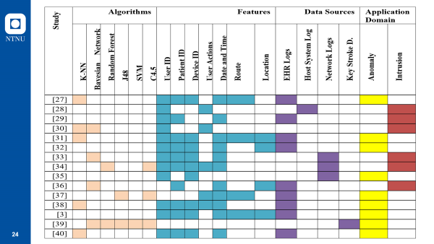

Slide 8
Gap
Each of the literatures determined anormaly accesses or intrusion/maliciousness but none of the studies determined anormaly and further accessed these anomalies for maliciousness or intrusion.
Anormaly in healthcare does not necessary means maliciousness. They could be circumventions for therapeutic purposes in emergency situation

Slide 9
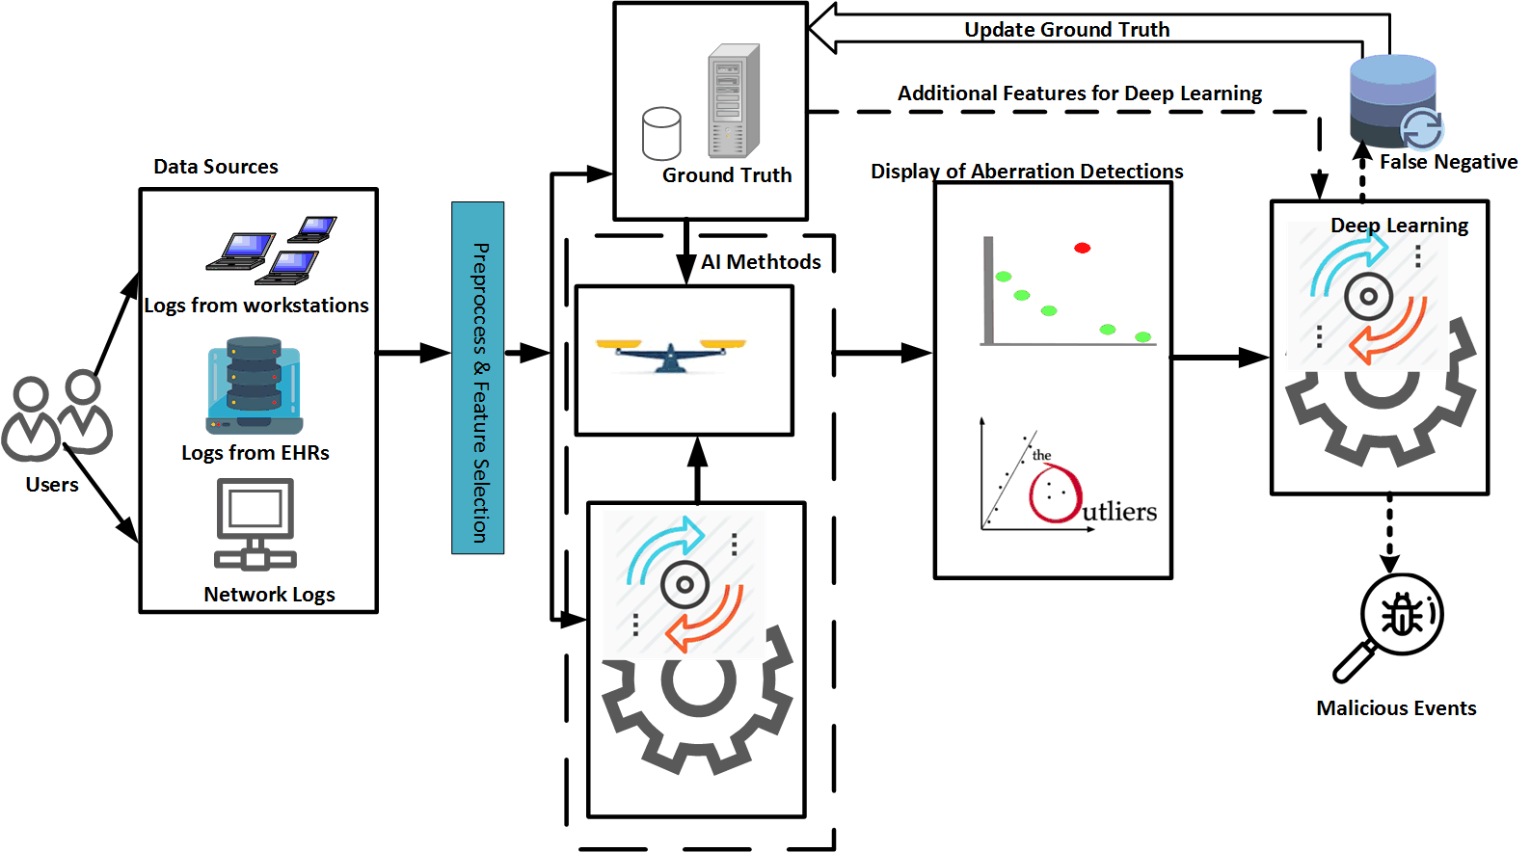
Framework

Slide 10
Simulated Data

Slide 11
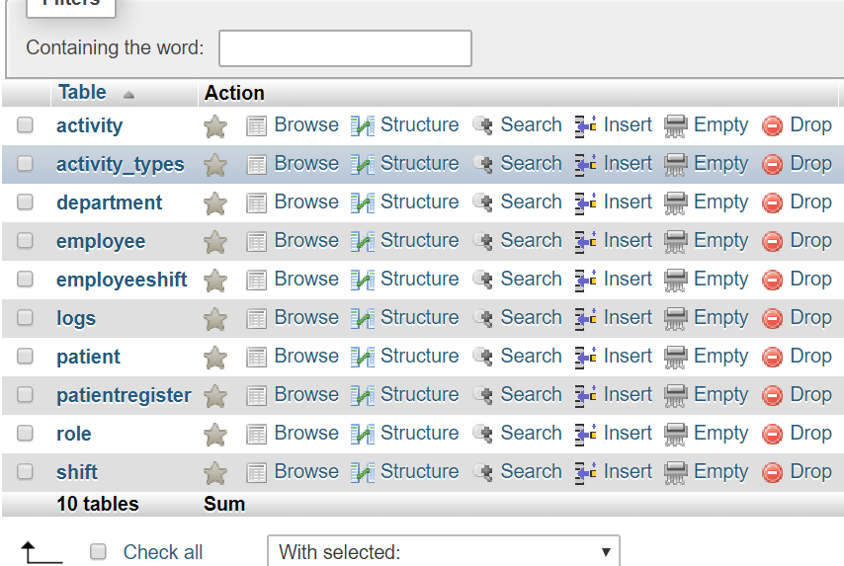
Simulated Database

Slide 12
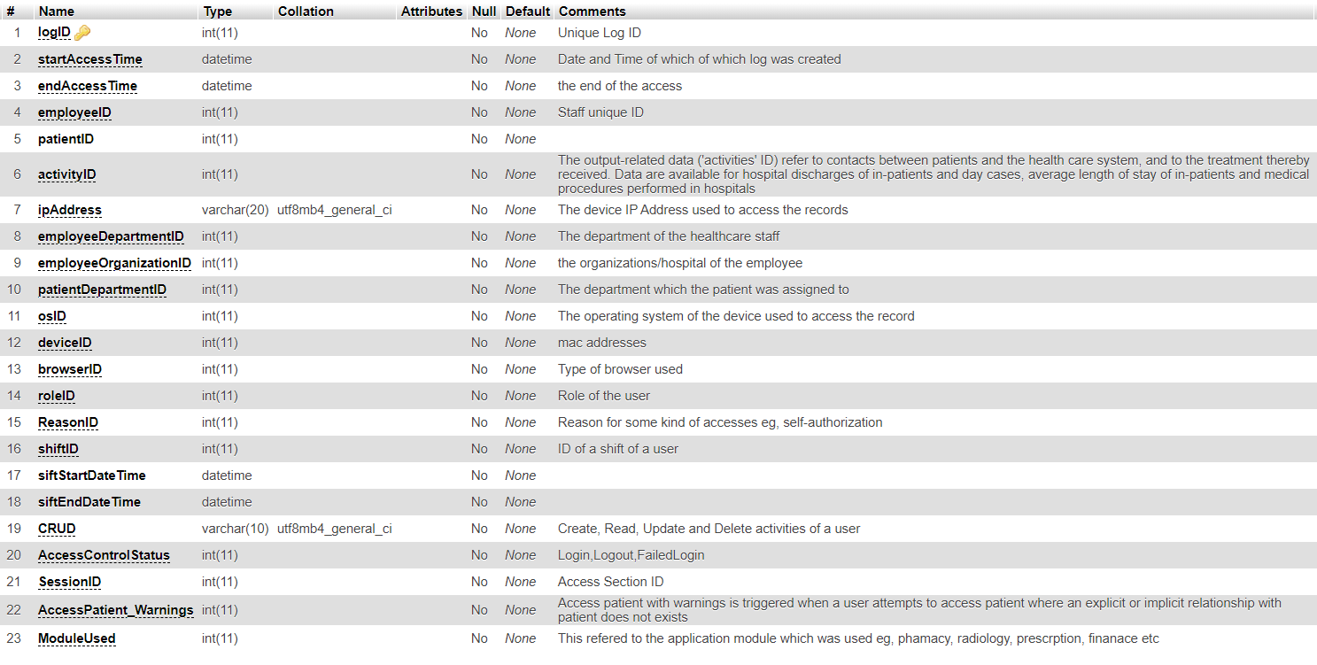
Features

Slide 13
How were the features created?
Guide from the literature review
Guide from code of conduct for healthcare security pratice of Norway
Guide from ISO 27799

Slide 14
On going activities
Domain expert to validate featurres
Data creation
Feature Selection
Model Design
Model Training and Testing

Slide 15
What to discuss Today Includes
Best ways to build the normal behavioural profile of each healthcare staff with the given features and use that to determine outliers?

